Slide 1
Strength of ties

Slide 2
Close Friends and Distant Acquaintances

Slide 3
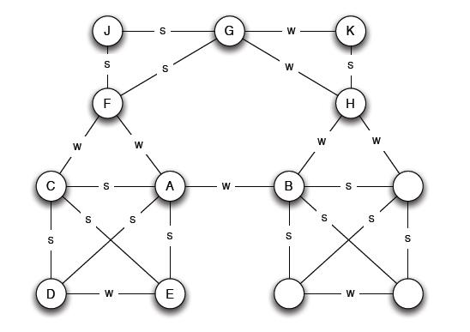
Bridge-Like Links
We saw how bridge-like links can be used in community detection (betweenness-based algorithms).
Today’s topic is about another aspect of bridge-like links. We will consider networks in which links can be classified as “strong” or “weak”. In such networks, bridge-like links must be “weak”.

Slide 4
Research in Sociology
One of the most cited article in social sciences (more than 59,000 citations according to Google Scholar) is the article “The Strength of Weak Ties” by Mark Granovetter, 1973. The author studied how people learned information leading to their current job. Here are the main results of his research and numerous follow-up studies:
Not surprising: Many people got this information through personal contacts.
More surprising: This information came from distant acquaintances much more often than from close friends.

Slide 5
How to Measure “Strength” of Ties?
Close friends and distant acquaintances. Ties between close friends are viewed as “strong”, while ties between distant acquaintances are viewed as “weak”. How to measure strength of ties?
Different measures. For example, the strength of ties between two nodes can be measured using the amount of interaction between them.
Simplified model. We will first consider a simplified model where each edge is labeled as either s (strong) or w (weak), as in the graph on the right.

Slide 6
Main Result (Informally)
Importance of bridges. In social networks, valuable information often comes from a different community. Communities are connected to one another by bridge-like links. Information is spread across communities using such links.
Weak ties. Bridge-like links are typically weak ties, not strong ones.
This statement has been verified experimentally, see section 3.4 in the book by Easley and Kleinberg .
We will formalize this statement and prove it.
Importance of weak ties. Thus, weak ties are important for spreading information across communities.

Slide 7
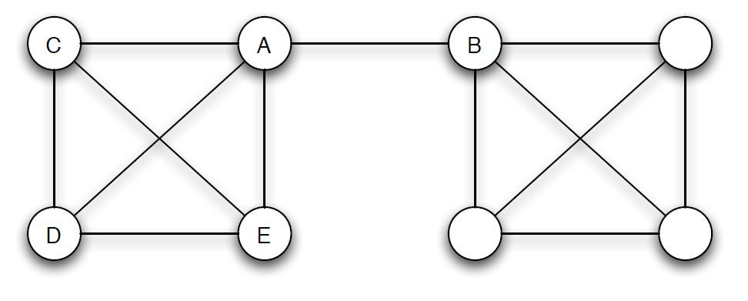
Bridges
In graph theory, an edge in a graph is called a bridge if removing this edge from the graph increases the number of connected components.
bridge

Slide 8
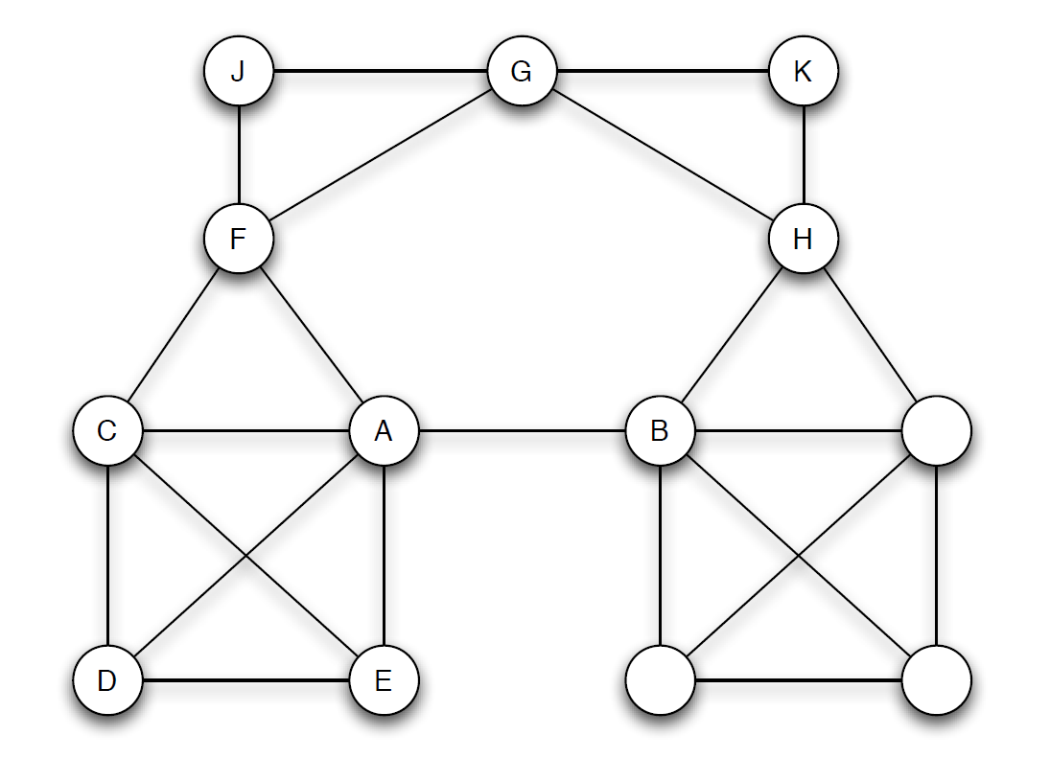

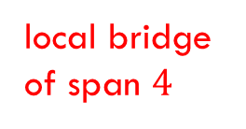
Local Bridges
Definition. Let $(u,v)$ be an edge in a graph $G$. The span of $(u,v)$ is the distance between $u$ and $v$ in the graph obtained from $G$ by removing the edge $(u,v)$. An edge is a local bridge if its span is at least $3$.
In social networks, communities are connected to one another by local bridges with large spans. Thus, local bridges play key roles in the dissemination of information.
local bridge
of span $4$

Slide 9
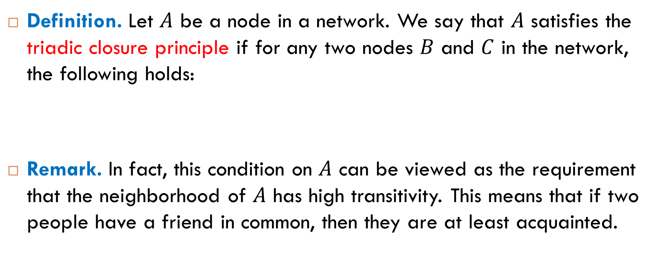
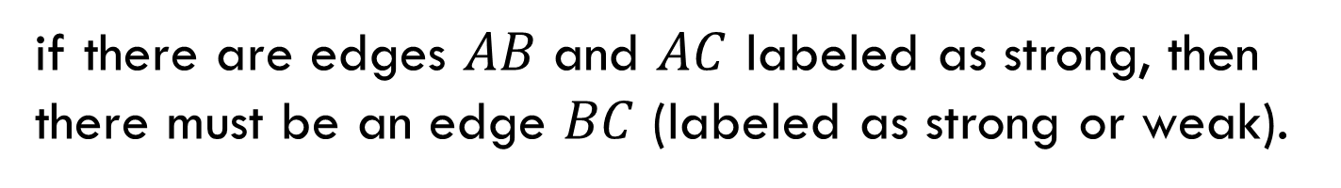
Triadic Closure Principle
Definition. Let $A$ be a node in a network. We say that $A$ satisfies the triadic closure principle if for any two nodes $B$ and $C$ in the network, the following holds:
Remark. In fact, this condition on $A$ can be viewed as the requirement that the neighborhood of $A$ has high transitivity. This means that if two people have a friend in common, then they are at least acquainted.
if there are edges $AB$ and $AC$ labeled as strong, then there must be an edge $BC$ (labeled as strong or weak).

Slide 10
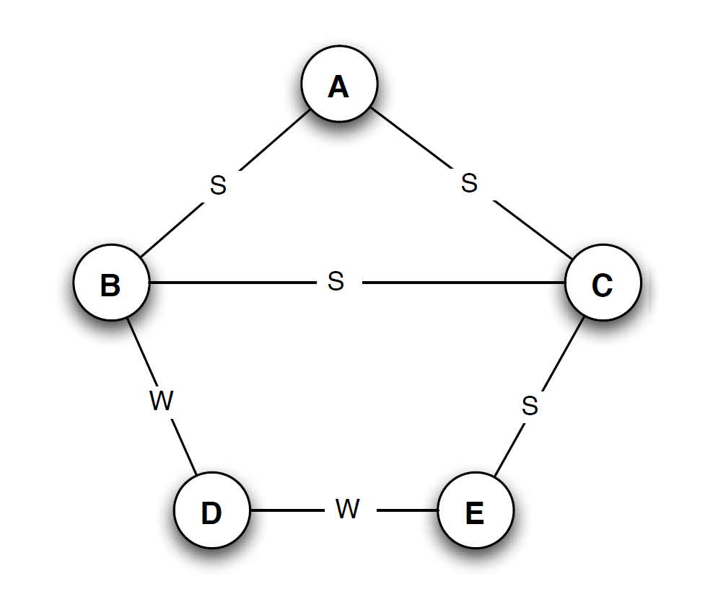
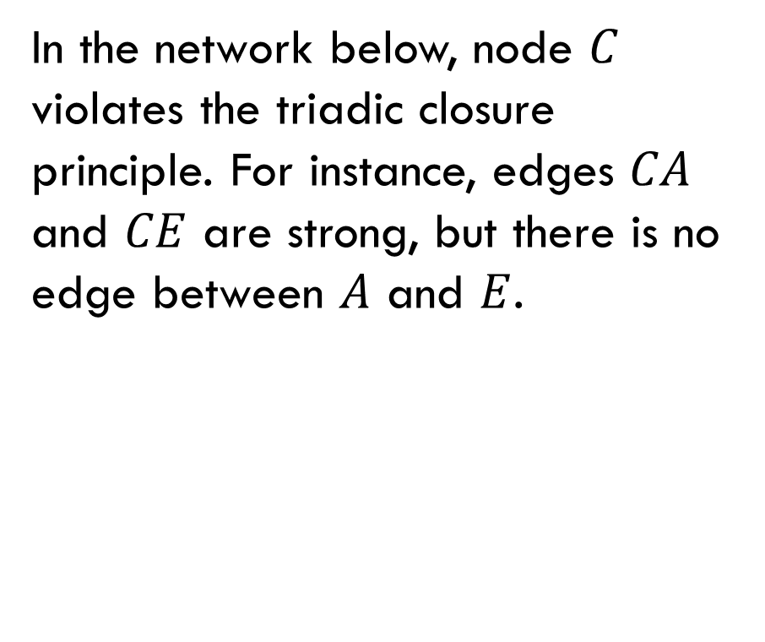
Examples
All nodes in the network below satisfy the triadic closure principle:
In the network below, node $C$ violates the triadic closure principle. For instance, edges $CA$ and $CE$ are strong, but there is no edge between $A$ and $E$.

Slide 11
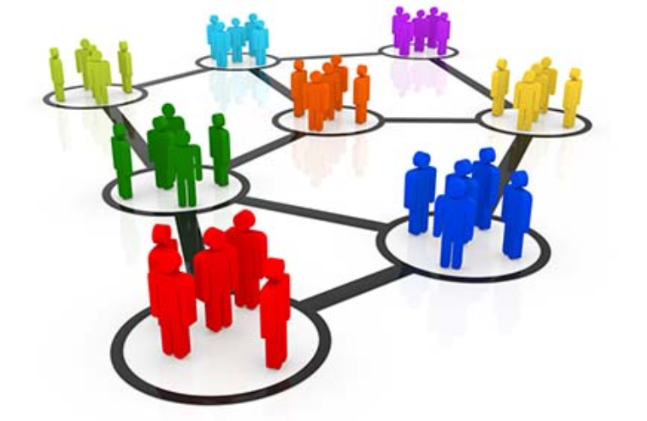
Local Bridges and Weak Ties
Theorem. Let 𝐴 be a node that has at least two strong ties. Then, if 𝐴 satisfies the triadic closure principle, any local bridge from 𝐴 must be a weak tie.
Proof. See the next slide.
Informal corollary. Weak ties (distant acquaintances) are very important for us!
weak tie

Slide 12
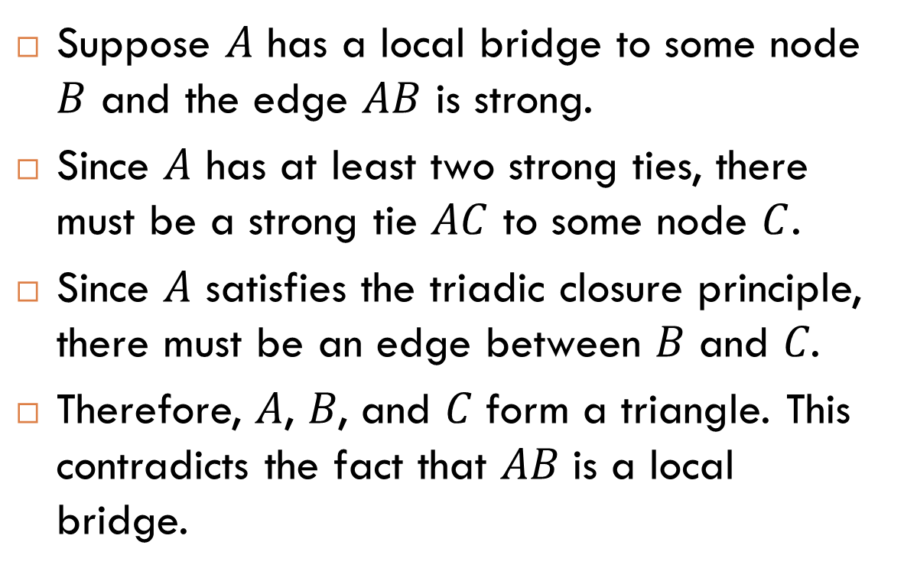
Proof (by Contradiction)
Suppose $A$ has a local bridge to some node $B$ and the edge $AB$ is strong.
Since $A$ has at least two strong ties, there must be a strong tie $AC$ to some node $C$.
Since 𝐴 satisfies the triadic closure principle, there must be an edge between 𝐵 and 𝐶.
Therefore, 𝐴, 𝐵, and 𝐶 form a triangle. This contradicts the fact that 𝐴𝐵 is a local bridge.

Slide 13
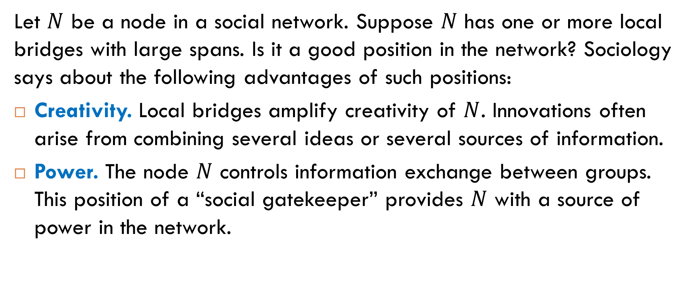
Sociological Aspect
Let $N$ be a node in a social network. Suppose $N$ has one or more local bridges with large spans. Is it a good position in the network? Sociology says about the following advantages of such positions:
Creativity. Local bridges amplify creativity of $N$. Innovations often arise from combining several ideas or several sources of information.
Power. The node $N$ controls information exchange between groups. This position of a “social gatekeeper” provides $N$ with a source of power in the network.

Slide 14
Other Measures of “Bridgeness”

Slide 15
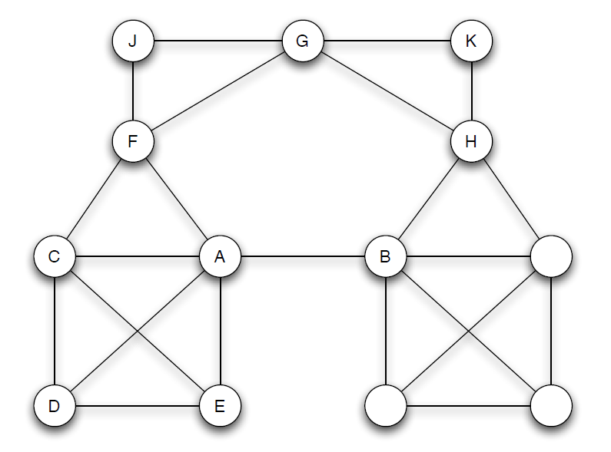

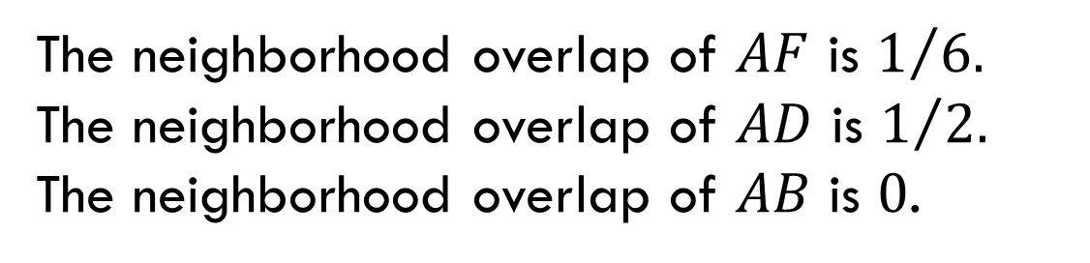
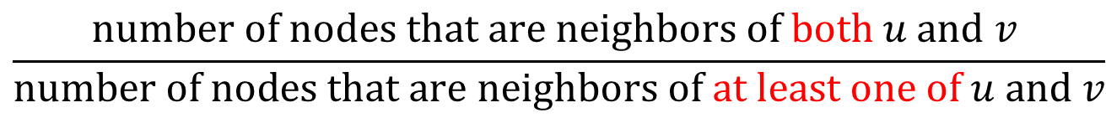
Neighborhood Overlap
Definition. The neighborhood overlap an edge connecting nodes $u$ and $v$ is the fraction
where in the denominator we do not count $u$ and $v$ themselves.
Example
$$\frac{\text{number} \text{of} \text{nodes} \text{that} \text{are} \text{neighbors} \text{of} \text{both} u \text{and} v }{\text{number} \text{of} \text{nodes} \text{that} \text{are} \text{neighbors} \text{of} \text{at} \text{least} \text{one} \text{of} u \text{and} v}$$
The neighborhood overlap of $AF$ is $1/{6.}$
The neighborhood overlap of $AD$ is $1/{2.}$
The neighborhood overlap of $AB$ is $0$.

Slide 16
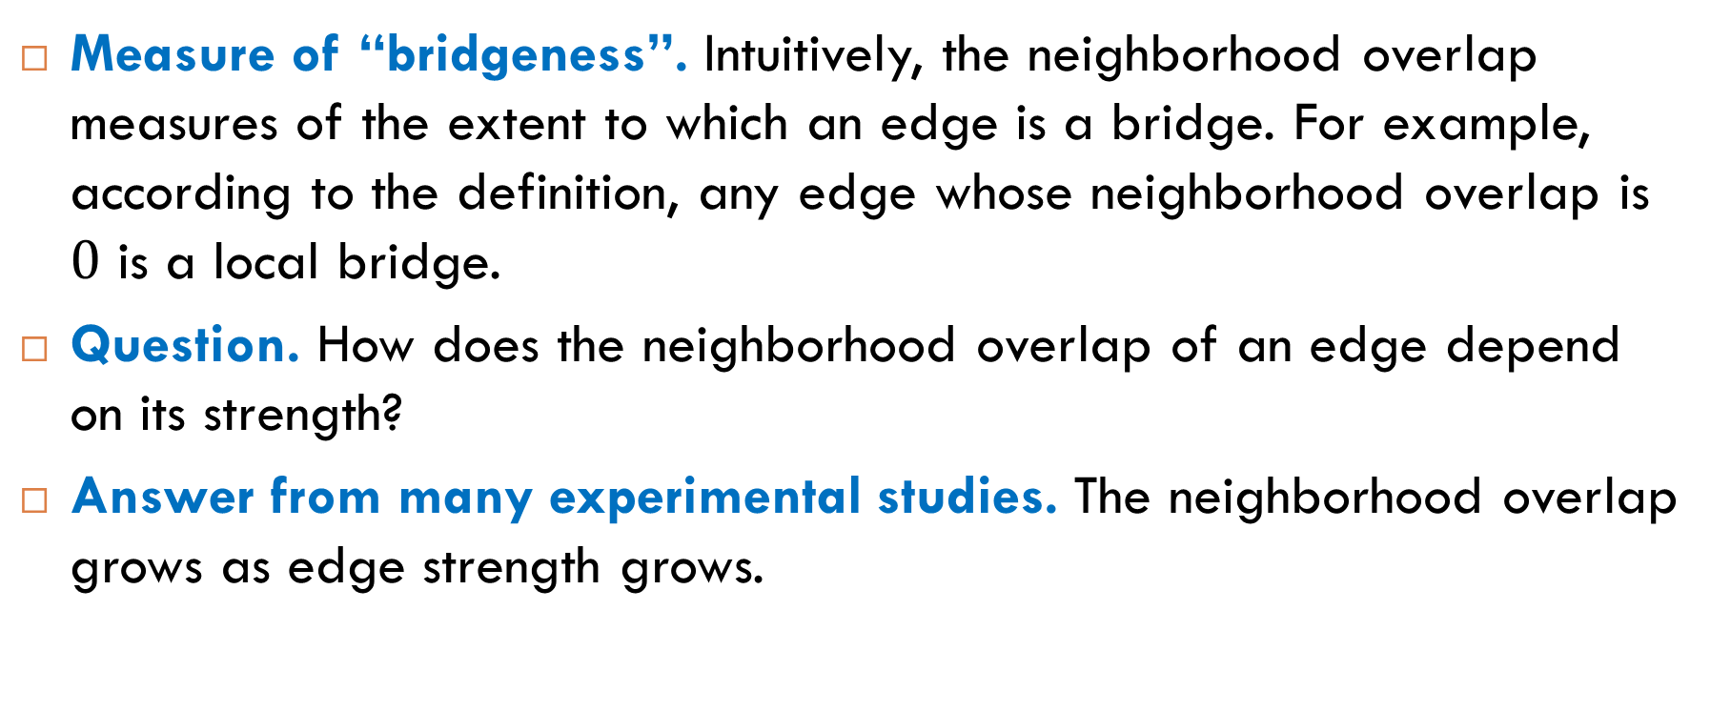
Experimental Study
Measure of “bridgeness”. Intuitively, the neighborhood overlap measures of the extent to which an edge is a bridge. For example, according to the definition, any edge whose neighborhood overlap is $0$ is a local bridge.
Question. How does the neighborhood overlap of an edge depend on its strength?
Answer from many experimental studies. The neighborhood overlap grows as edge strength grows.

Slide 17
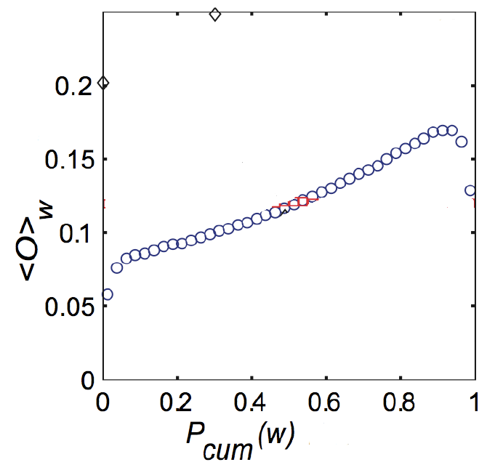
Example (Mobile Communication Network)
A plot of the neighborhood of edges as a function of their percentile in the sorted order of all edges by their strength. The overlap increases with increasing tie strength.

Slide 18
Experimental Studies
Facebook and Twitter (Easley & Kleinberg, Section 3.4)

Slide 19
Examples of Questions
A user in a social network maintains hundreds of friendship links. How many of these links correspond to strong ties that involve frequent contact and how many correspond to weak ties that are activated relatively rare?
How the number of a user’s strong ties depend on the number of followers?

Slide 20
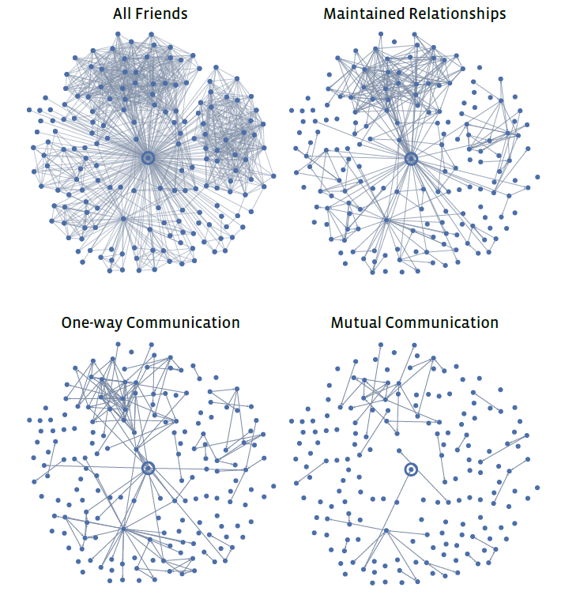
Strength of Ties on Facebook
Mutual communication: Exchange by messages during the observation period.
One-way communication: The user sent one or more messages, whether or not these messages were reciprocated.
Maintained relationship: The user followed information about the friend, whether or not actual communication took place.

Slide 21
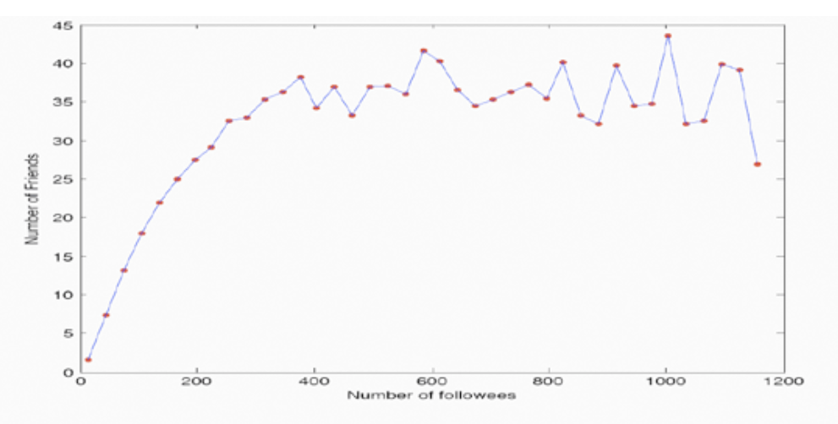
Strong Ties and Followers on Twitter

Slide 22
Different Types of Nodes
Embeddedness and Structural Holes
(Easley & Kleinberg, Section 3.5)

Slide 23
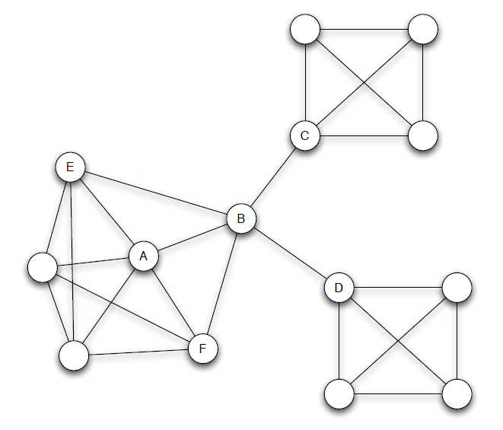
Node A: Embeddedness
Sociology:
It is easier for embedded nodes, like A, to trust one another and to have confidence in the integrity of transactions between them.
In the event of misbehavior by one of such nodes, there is the potential for reputational consequences from friends.

Slide 24
Node B: Spanning a Structural Hole
Sociology: Suppose the network represents collaboration among managers in a large company. Then node B spans structural holes in the organization.
Advantages of node B:
early access to information from different communities;
innovations often arise from unexpected combinations of information from different sources;
“social gatekeeping”, which means that only B learns information coming from both C and D’s groups.

Slide 25

Reading
Sections 3.2-3.5

